Slide 1
Outline box of single diagram

Slide 2
Outline of two side-by-side sub-diagrams

Slide 3
Outline of two stacked sub-diagrams

Slide 6





Inertial Frame
(Constant Velocity)
Non-Inertial Frame
(Accelerating)

Slide 7







$$z$$
$$z′$$
$$v$$
$$y$$
$$y′$$
$$x$$
$$x′$$

Slide 8
Aether flowing relative to earth
Earth moving relative to aether

Slide 9
Aether flowing relative to earth
Earth moving relative to aether

Slide 13


Slide 15
<S>
<S’>
D
u
L
D
W
W

Slide 16
u
D
L
D
W
W

Slide 18


<S>
<S’>
u
$$L_{2}$$
$$L_{1}$$

Slide 19


$$L_{2}$$
u
$$L_{1}$$

Slide 20
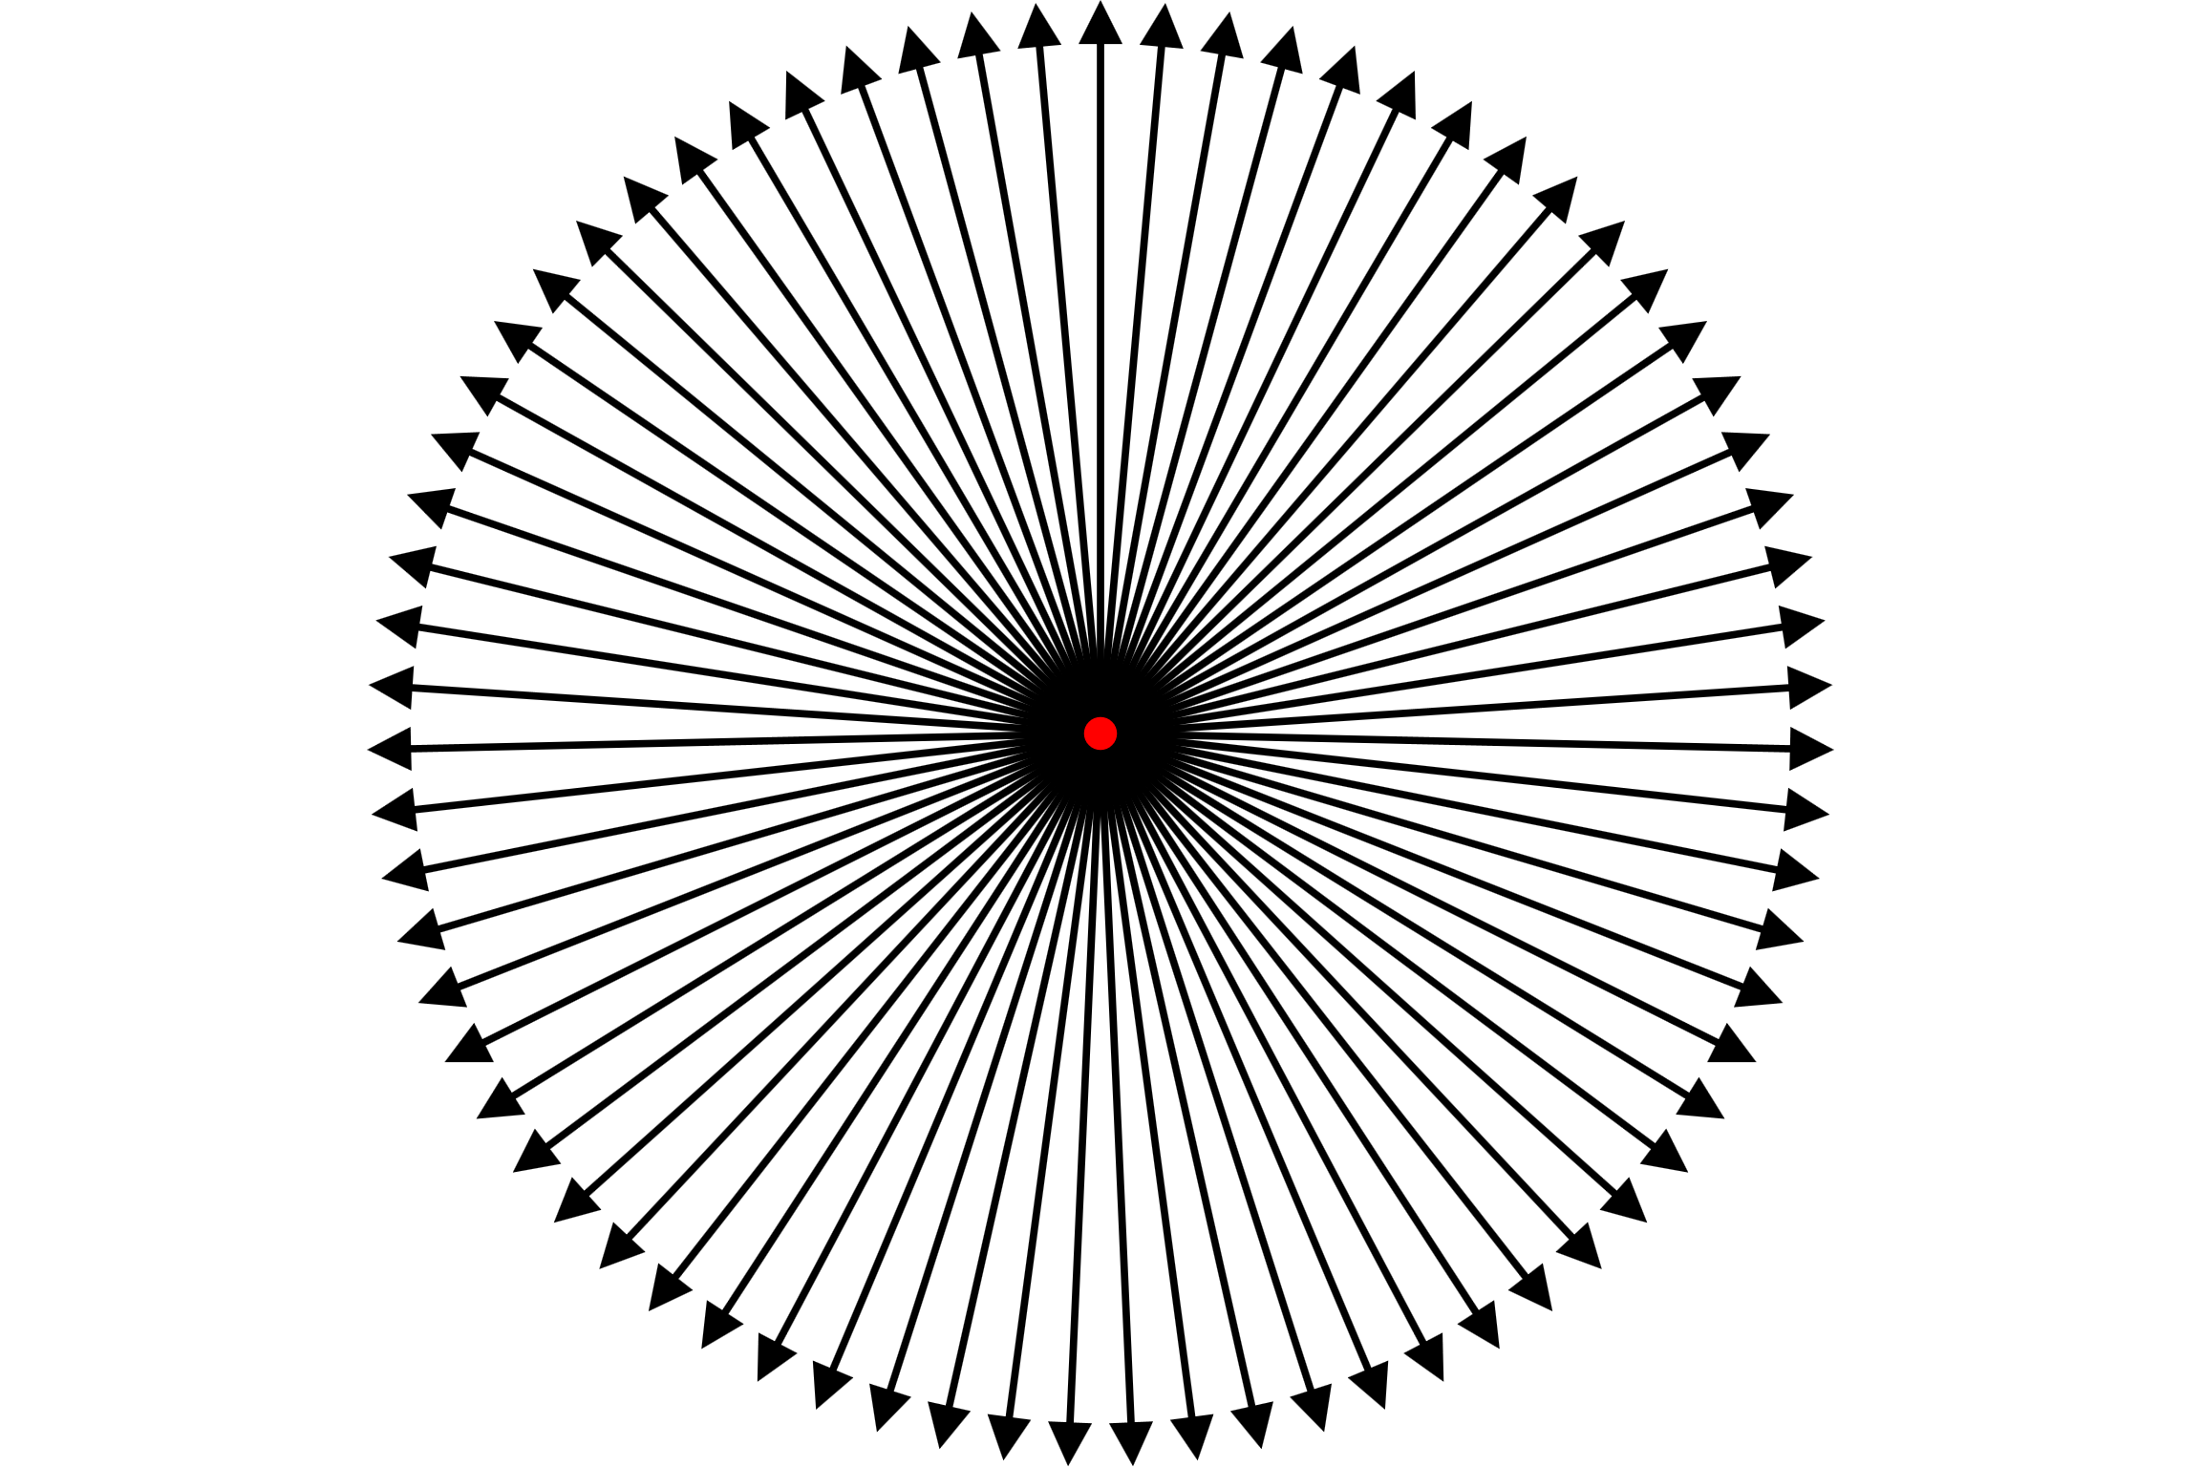
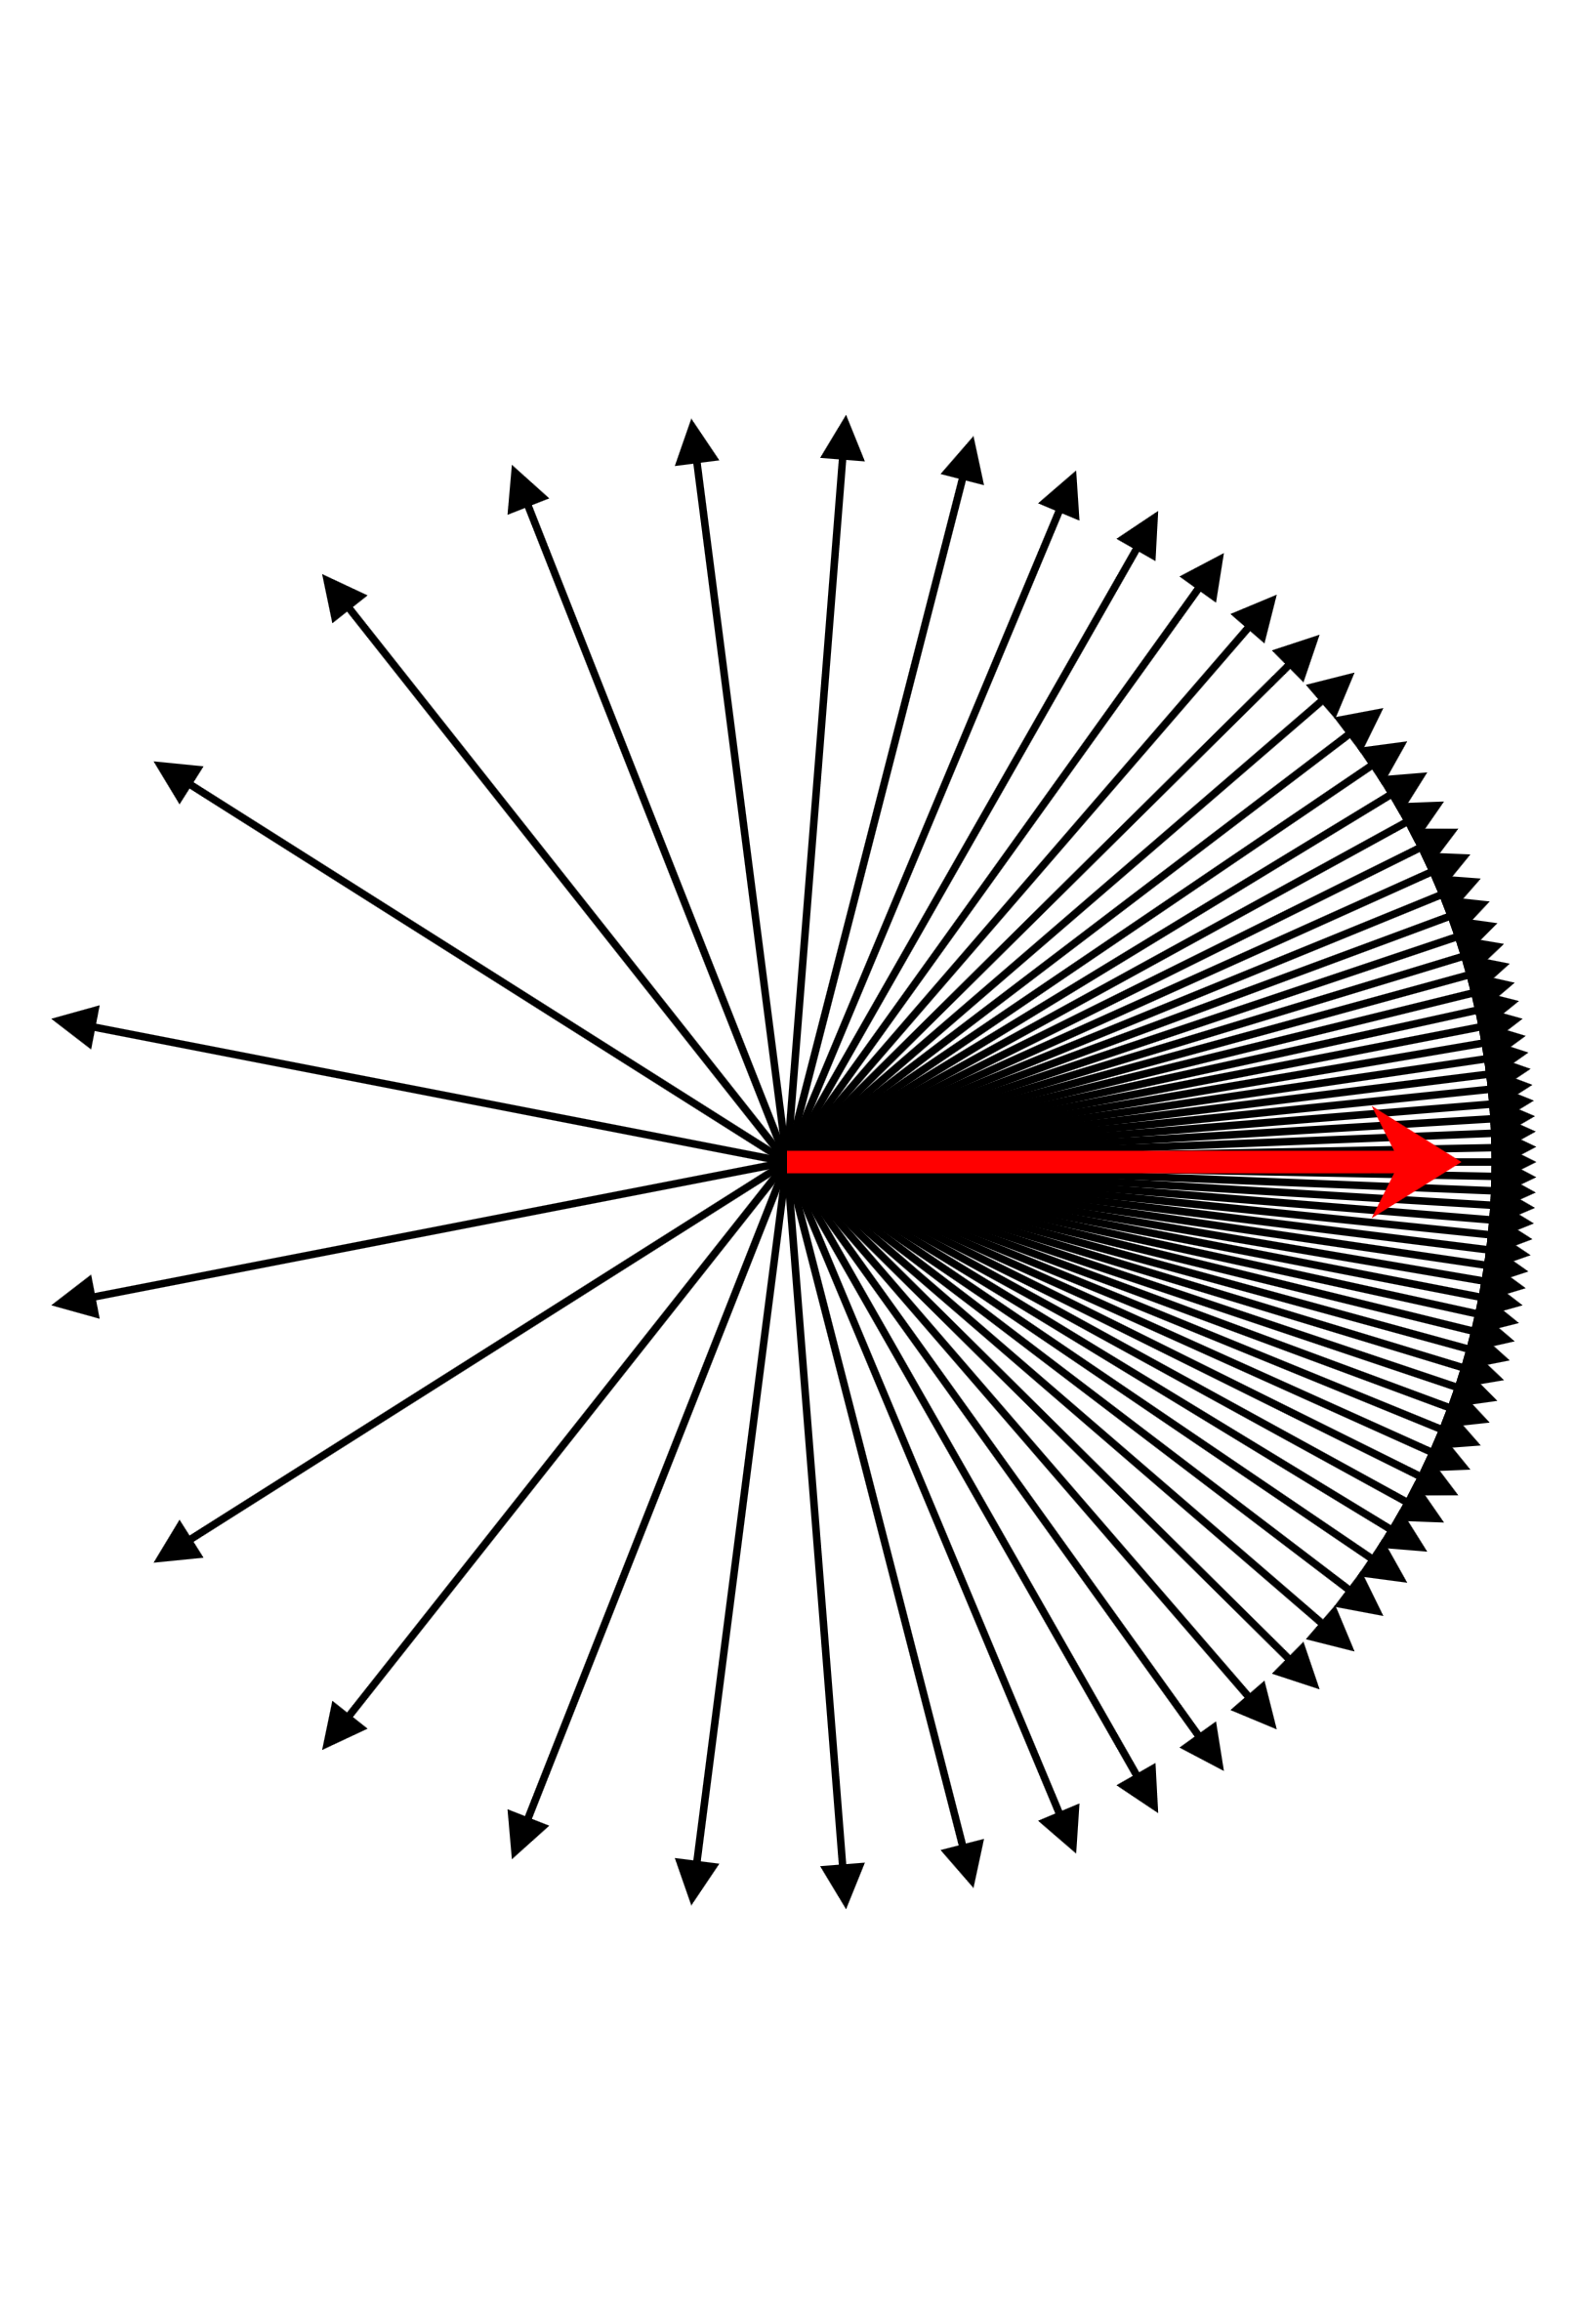

Slide 21
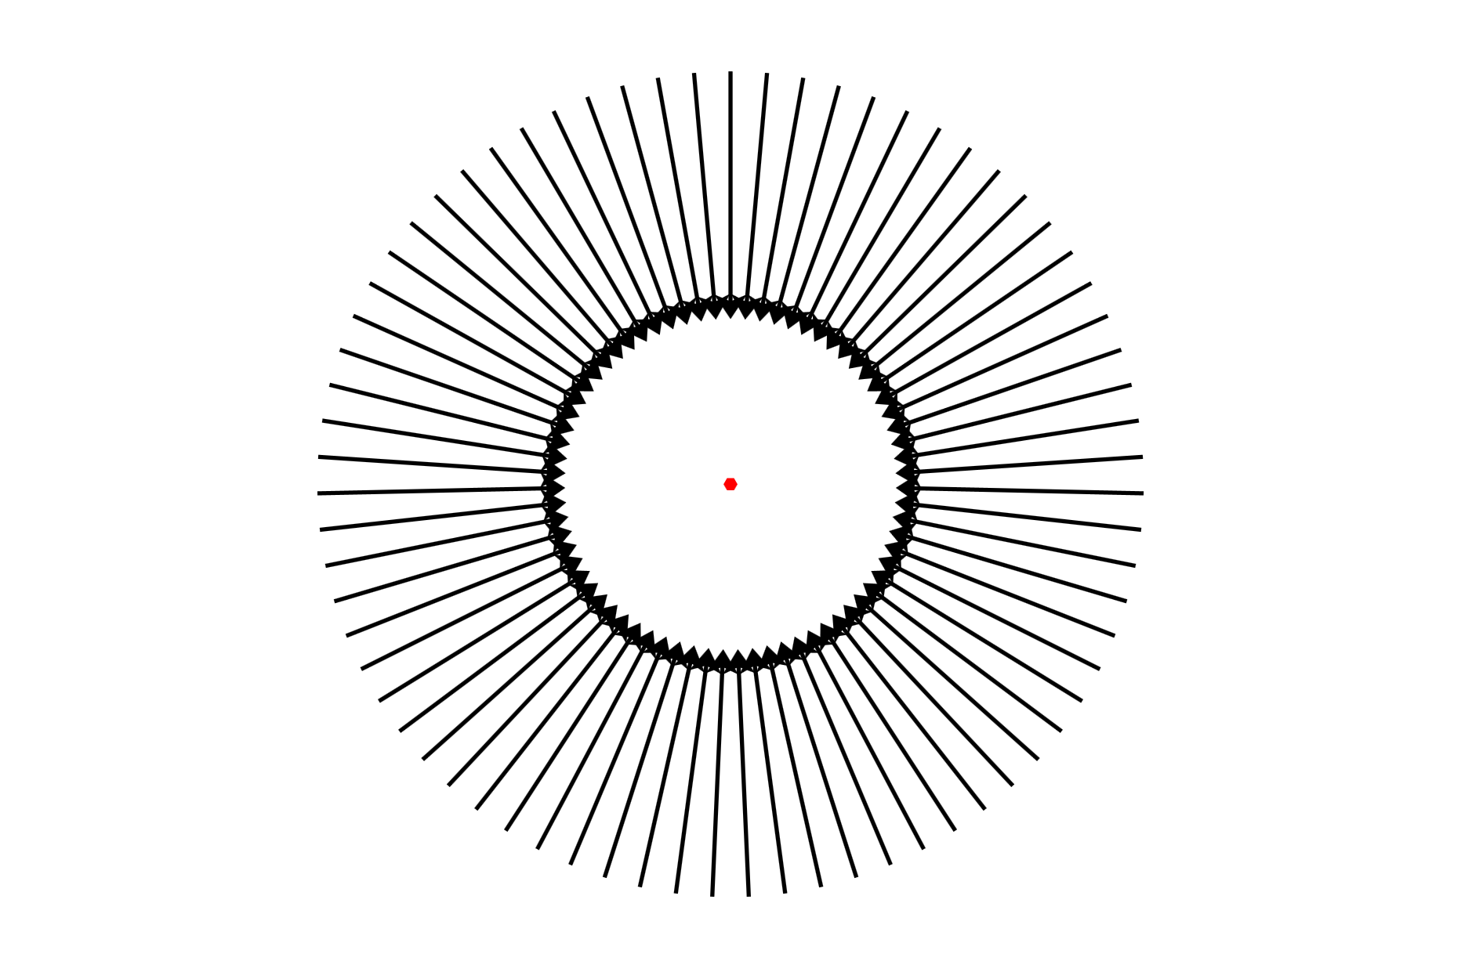
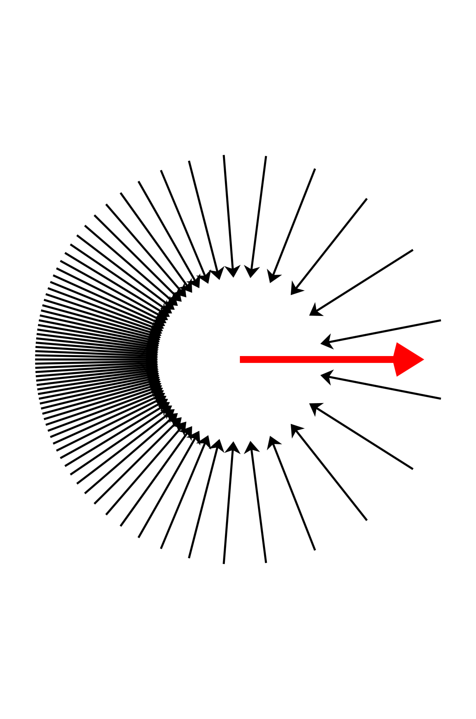

Slide 27
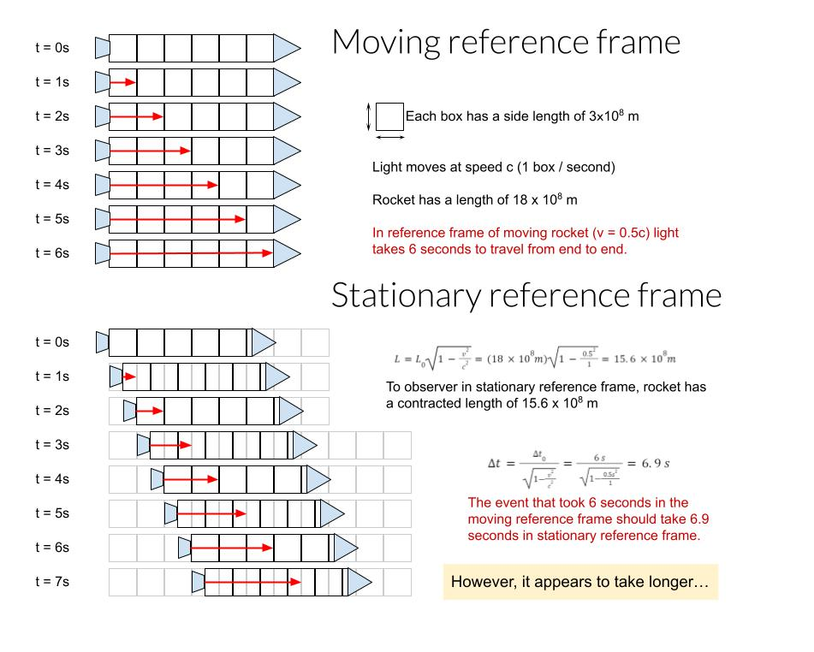
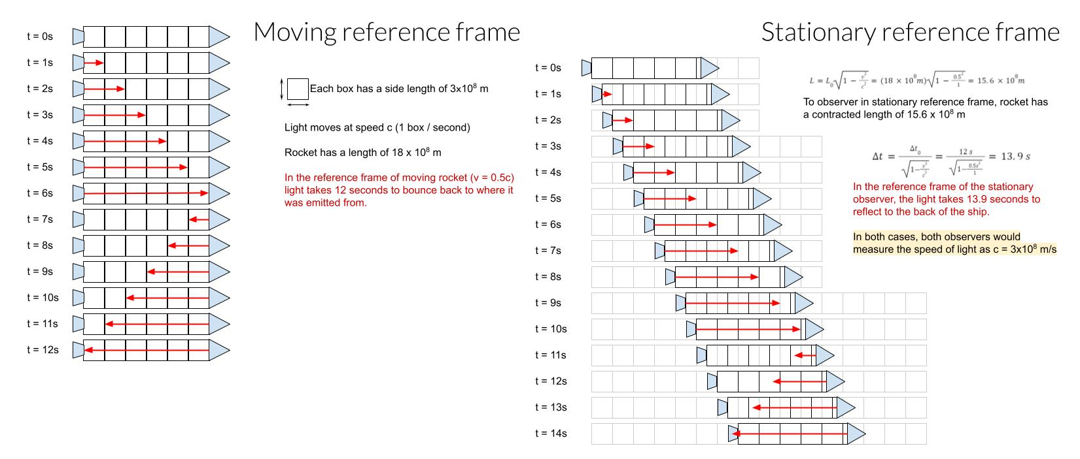

Slide 29

3/4 c
1 light year
3/4 c
3/4 c
t = 0
t = 0
t = 1 year
t = 4/3 years

Slide 31
Notes:
(is this correct, look at aether calculations) To be an analogy of aether model should the rocks not be floating balls that float with the current at its speed, i.e. the aether effecting the fish’s speed and moving the floating balls to then lead to a difference, and the only reason the aether experiment gave the result it did was because the light speed was not affected, could still be aether but it would only effect objects motion but not the lightspeed

Slide 35



Slide 39
Mirror
L
L
Light sources
light pulses
half silvered mirror/ Beam splitter
Aether movement relative to equipment
Detector

Slide 40




